Slide 1






CRYPTO TRADING ROBOT
by Iñigo Larrea Pombo

Slide 2



PROCESS
Investigation
Programming
Testing & Debugging

Slide 3
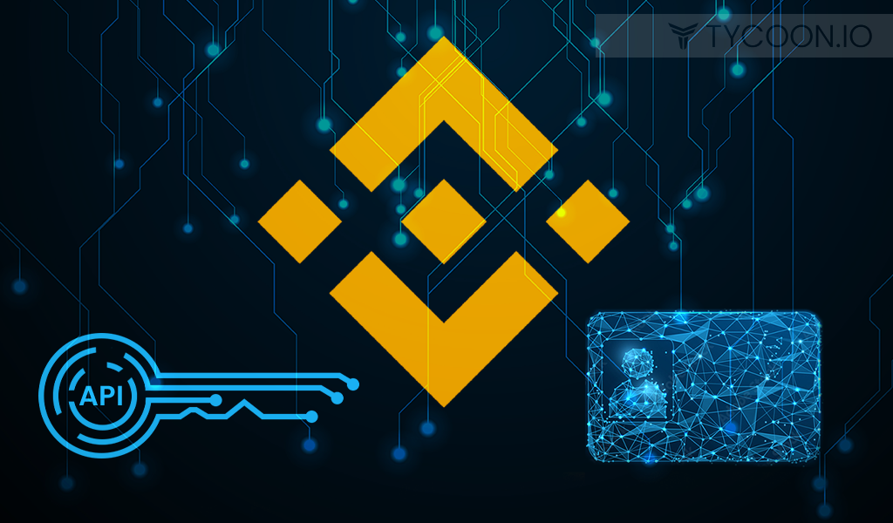
INVESTIGATION
BINANCE API
HOW TO ?
PERMISSIONS ?
COMMANDS ?

Slide 4

INVESTIGATION
TRADING
PREVIOUS KNOWLEDGE
BEST PRACTICES
ALGOTRADING

Slide 5
INVESTIGATION

Slide 6

Digital Communications
Cloud
Local
Hybrid

Slide 7

Thank You
pombo7676@gmail.com

